Slide 1

Group Gamma

Slide 2
Group Gamma Members
Zachary Maziarz – lives in Alabama and works as a Business Analyst for a bank.
Jeremiah Kellam - lives in Indiana and works in quality control at a soda factory.
Emily Wojan – lives in Texas and works as an Administrative Assistant.
Julian Gomez Jr - lives in Texas and works as a Compliance Analyst for a bank.

Slide 3
Bacchus Case Study
The Bacchus Winery case study is based on a family business taken over by two brothers, Stan and Davis Bacchus. The brothers aimed to incorporate new business methods to improve the products and customer service. Some of the key points are listed below as the case study was explained:
There are twenty-seven employees listed in the case study with varying responsibilities.
The winery itself produces four types of wines that are listed as Merlot, Cabernet, Chablis, and Chardonnay.
There are only three suppliers to the Bacchus winery that provide the raw materials listed in the case study.
The case study focused on building an annual snapshot of the business to assess the state of their inventory, the wine distribution, and their employee’s hours.

Slide 4

Reports Provided
Report # 1 – Employee Hours Report, see slide no. 6
Report # 2 – Supply Orders Report, see slide no. 7
Report #3 – Wine Sales Report, see slide no. 8
Report #4 – Wine Distribution, see slide no. 9

Slide 5
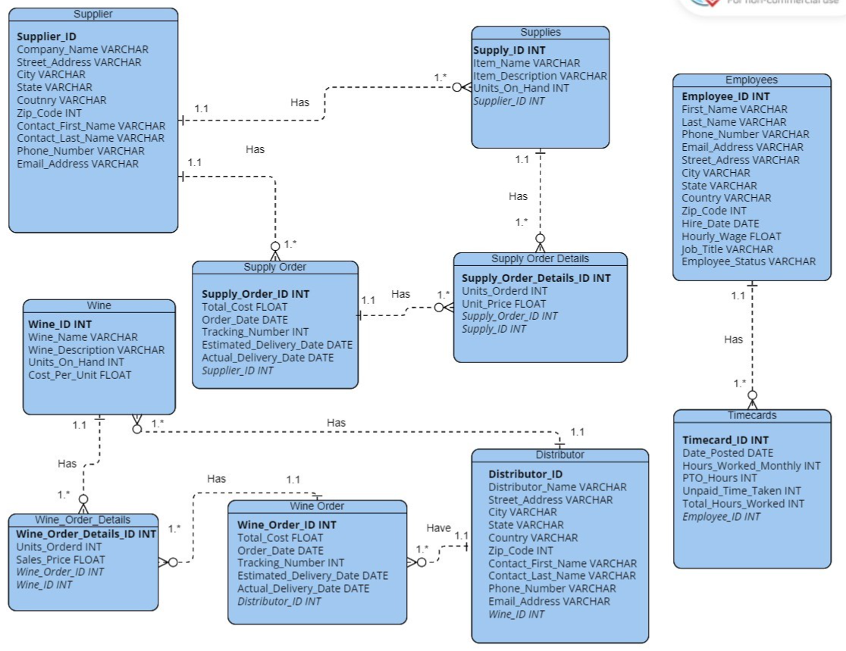
Group ERD

Slide 6
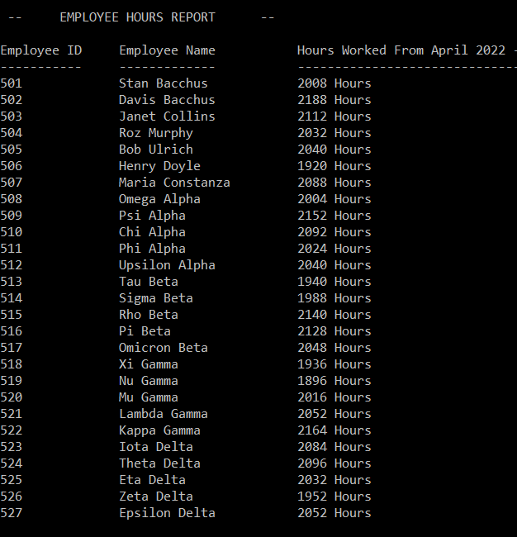
Employee Hours Report
In our Employee Hours Report, we are pulling back each employee's hours over the last 4 quarters.
In this report, we are selecting from two separate tables we have created.
One table is our employees, and the other is timecards. The employee's table houses employee information such as name, contact, employee id, address, position, etc. The timecards table has the employee id as a foreign key and shows the total hours worked for each associate per month. The table also displays PTO taken as well as non-paid time off taken during that month.
In this report, we return the employee id, a concatenation of the employee's first and last name, and a sum of the total hours that the employee has worked over the course of the last 4 quarters.

Slide 7
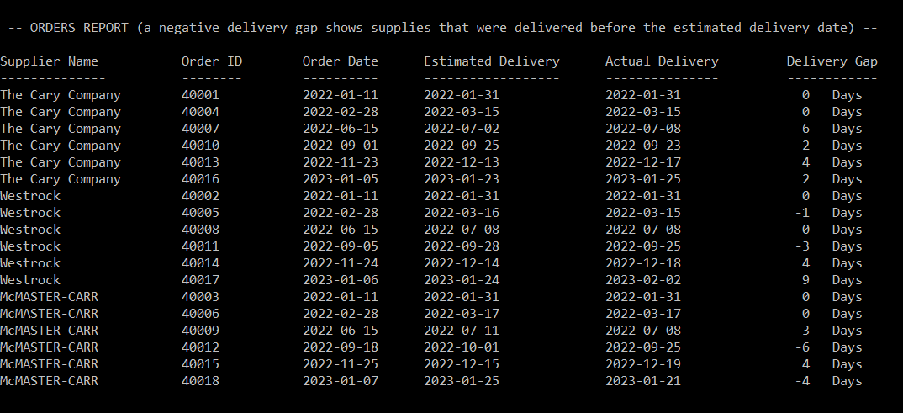
Supply Orders Report
In our Supply Order report, we get the Supplier Name, the Supply Order ID, Order Date, the Estimated Delivery Date, the Actual Delivery Date, and the Delivery Gap. This report provides the company with a snapshot of each order they have made along with the supplier they ordered from and the gap between the estimated delivery date they gave and the actual delivery date of the items.
The report will display a positive number for the Delivery Gap if the Actual Delivery date is later than the estimated delivery date. The report will display a negative number for the Delivery Gap if the Actual Delivery date is sooner than the Estimated Delivery Date is given.
Delivery Gap will be based on calendar days between the estimated and actual delivery day, not business days.

Slide 8
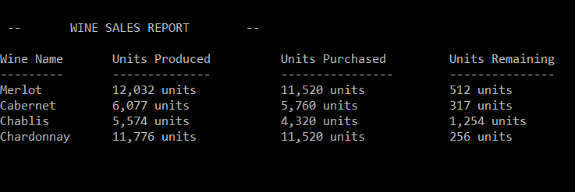
Wine Sales Report
In our Wine Sales report, we retrieve the Wine name, Units produced, Units sold, and Units remaining of each wine.
This report provides the quantity sold of each wine and gives the stock amount in units that we still have on hand at the winery.
To calculate the amount produced reporting field, we took the sum of units on hand for each wine and the amount ordered for each wine. We then took the amount ordered to get the units sold. Lastly, we calculated the amount remaining of each wine by taking the sum of units on hand and units ordered and subtracting it from the units ordered.
Each wine (and its sales) was distinguished by its wine id from the database.

Slide 9
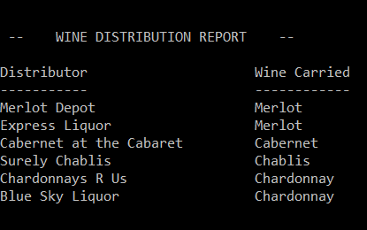
Wine Distribution Report
In our Wine Distribution report, we retrieved the Distributor name and Wine name in order to show which Distributor carries which wines.

Slide 10
Assumptions Made
The winery could not place one order for supplies from each supplier; instead, they would have to place an order for each supplier and supply orders would be placed as needed.
The suppliers would provide an ETA for all orders that the winery made and that each order would be shipped once all items in the order have been fulfilled - meaning each order would have one tracking number.
Each distributor will have individual orders and that partial shipments could be made for the wine orders, so each one could have many tracking numbers.

